Slide 1

Cloud Platforms in the Era of Generative AI: Current Trends and Open Challenges
Minchen Yu
School of Data Science
The Chinese University of Hong Kong, Shenzhen
November 2025

Slide 2
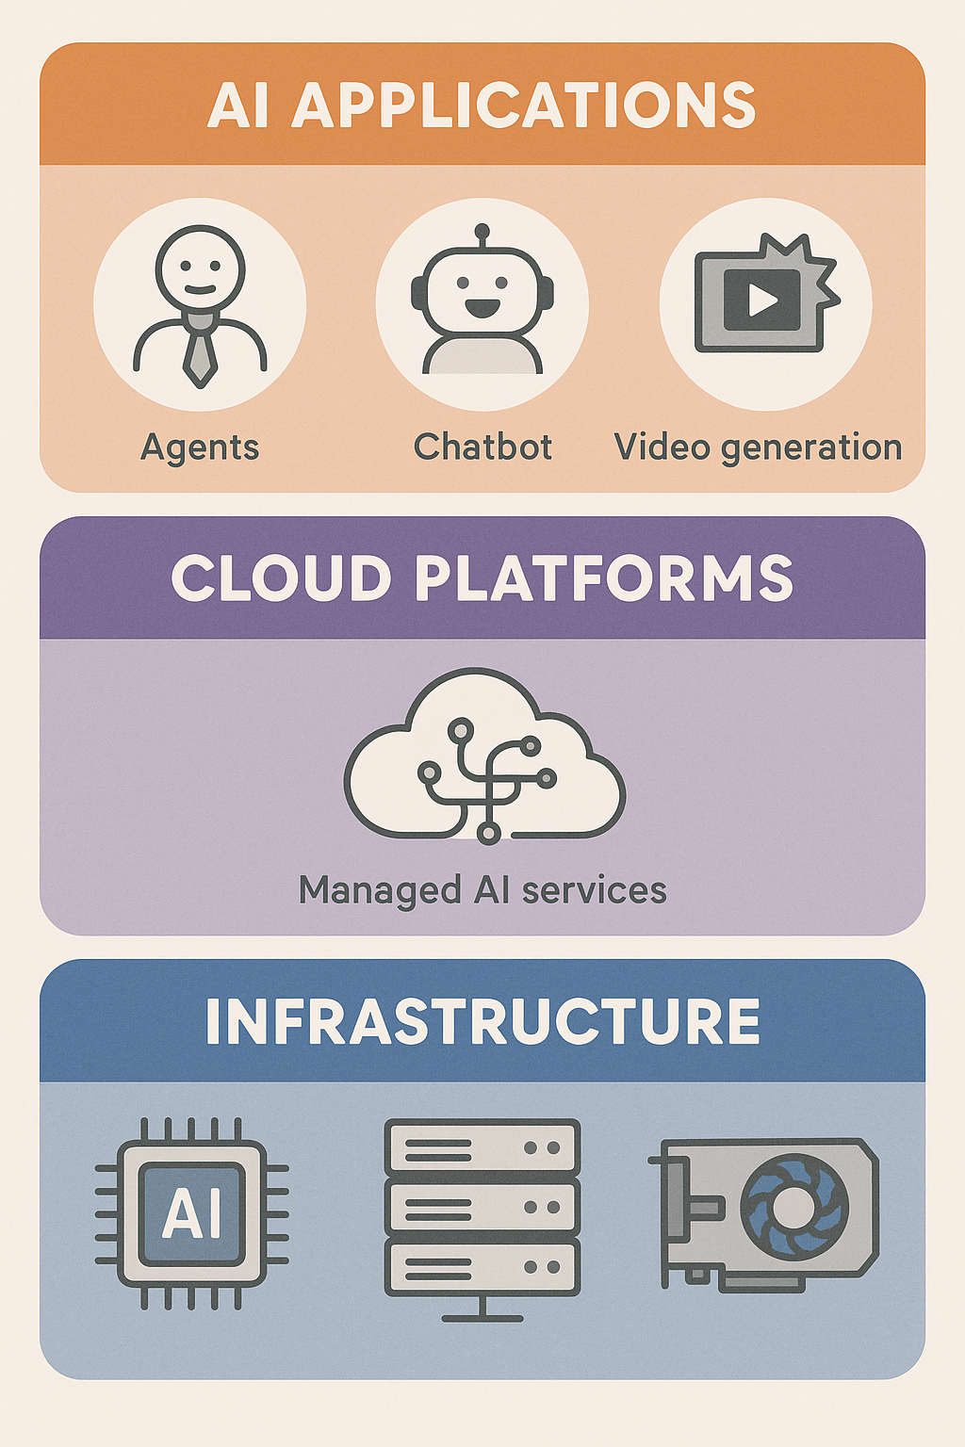
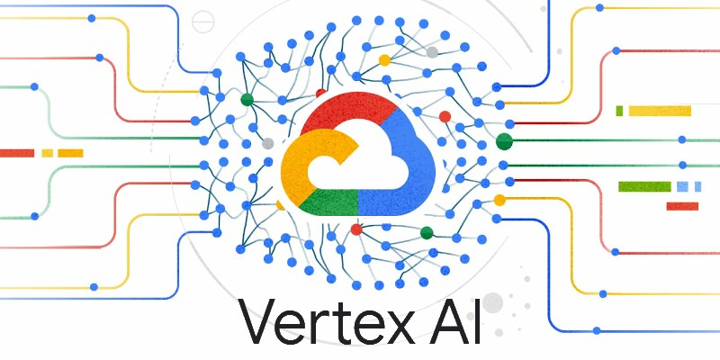


Cloud Platforms for Generative AI
Generative AI applications
Agents and autonomous systems backed by LLMs
Image and video generation
…
The rise of AI cloud platforms
Datacenters equipped with AI accelerators
Managed AI services (e.g., inference endpoints)

Slide 3
Goals for
AI Cloud Platforms
Scalability
Efficiently run generative AI applications at scale
Resource efficiency & cost effectiveness
High resource utilization and performance/$
Usability
Ease-of-use for AI developers and engineers

Slide 4
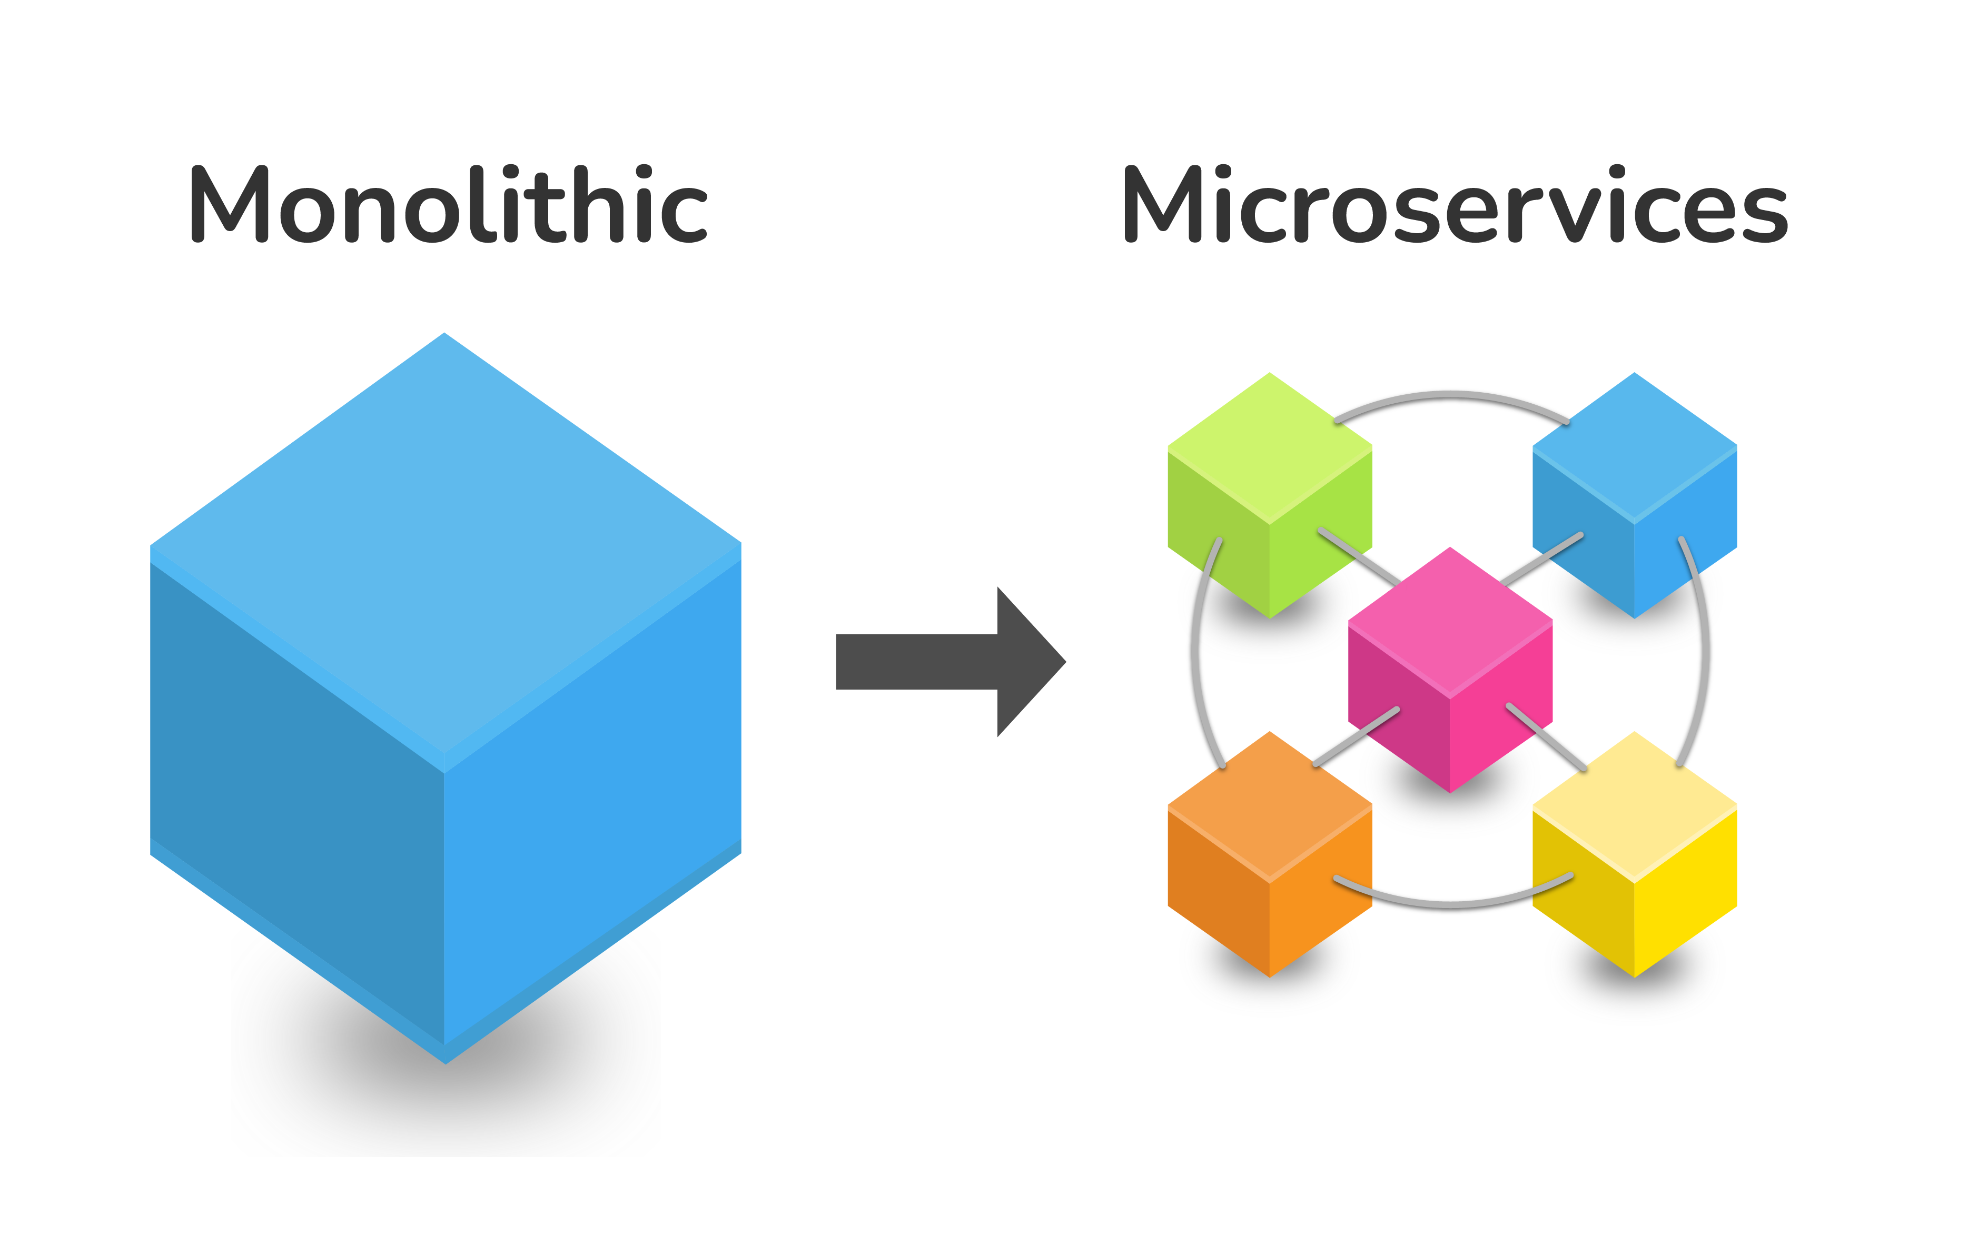
What We Do for General-Purpose Cloud?
Cloud-native approach that modularizes applications
“ … breaks applications into individual independent (micro)services, with each service focused on a specific functionality…makes them easier to deploy, update, and scale independently”^{[1]}
^{[1]} CNCF microservice architecture: https://glossary.cncf.io/microservices-architecture/

Slide 5

Can AI cloud follow this modular design paradigm?
Yes—enabled by three fundamental drivers

Slide 6
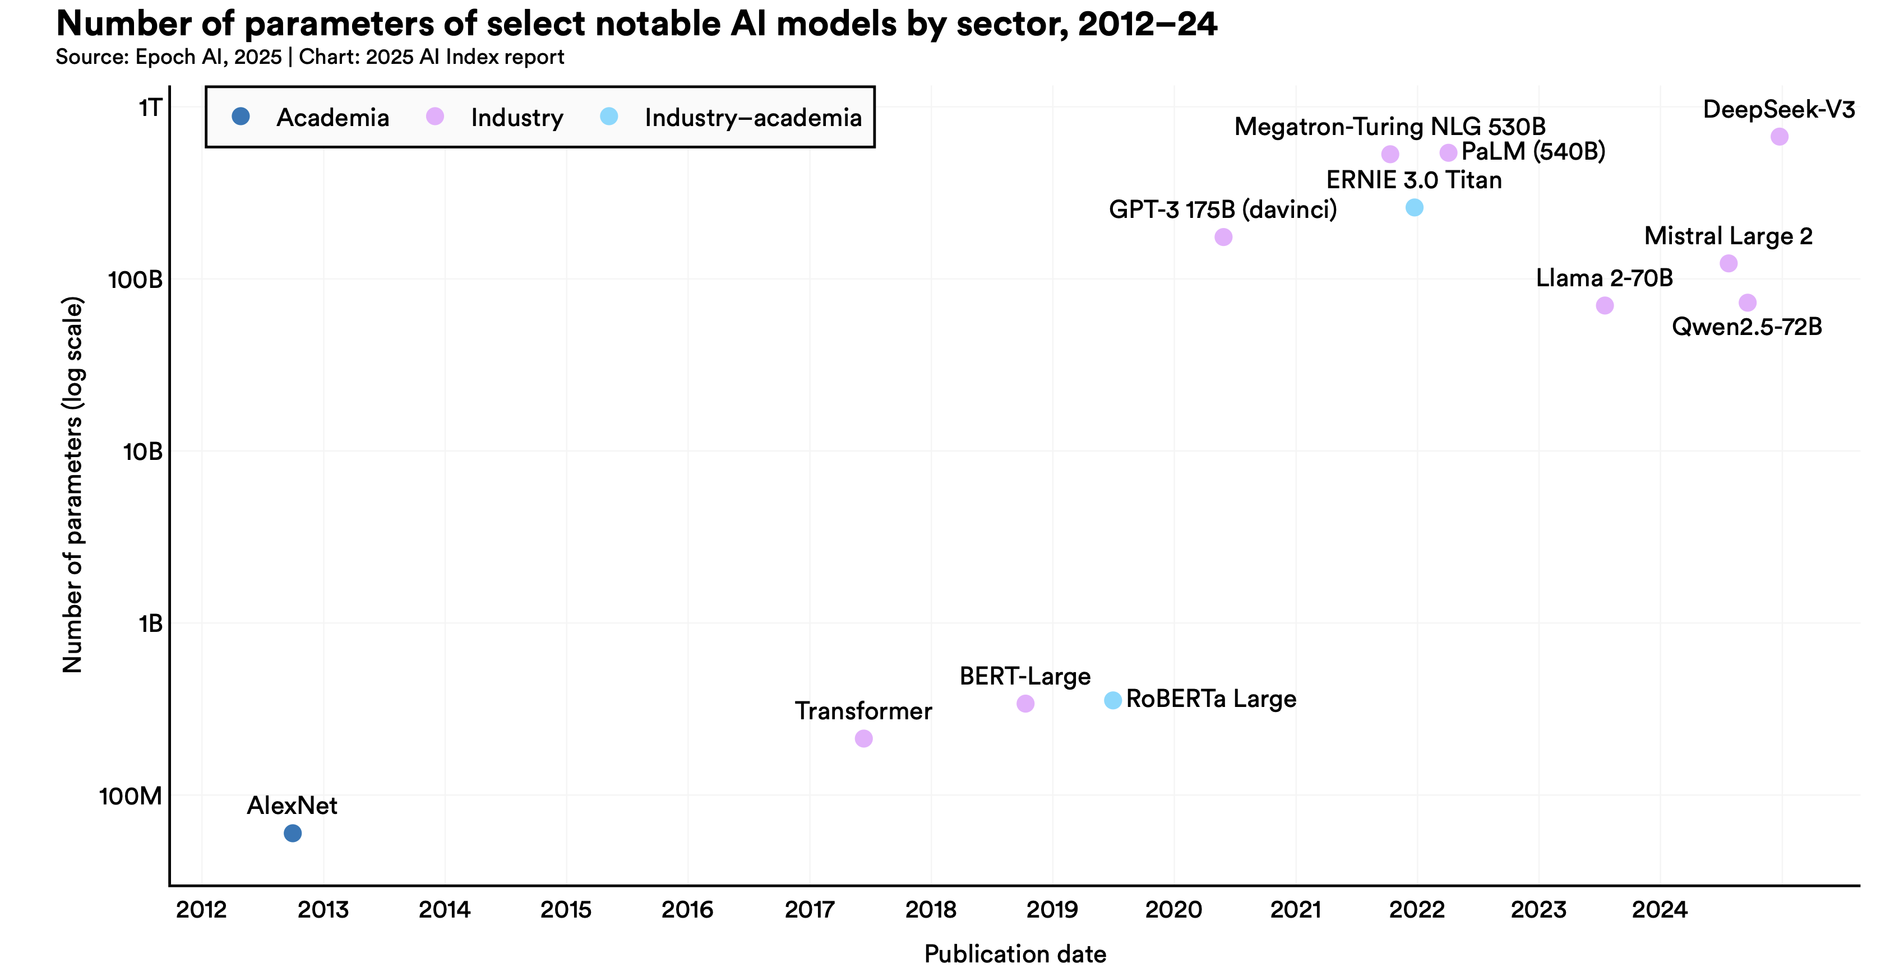
Modularization Driver #1: Model
Increasingly large and compute-intensive foundation models
Distinct computational demands across modules and inference phases
Prefill vs. decoding, modality-specific encoders, etc.
Current approaches for modular deployment
Prefill/decoding disaggregation
Attention/FFN disaggregation
Decoupled modality-specific components
1000x
Credit: Stanford AI Index Report 2025

Slide 7
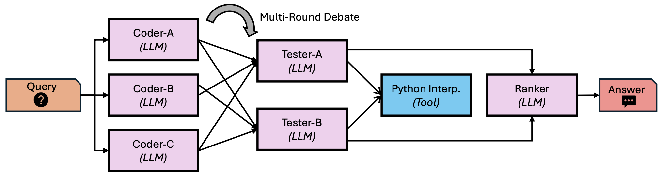
Modularization Driver #2: Application
End-to-end AI applications
Compound systems (e.g., multi-agent)
Executed as multi-stage workflows
Benefits from modular deployment
Independent scaling
Fine-grained resource allocation
Fault isolation
…
Code generation workflow^{[1]}
^{[1]} G. Chaudhry et al, “Towards Resource-Efficient Compound AI Systems”, HotOS’25

Slide 8
Modularization Driver #3: Infrastructure
Hardware resource heterogeneity
GPUs across generations
AI accelerators from various vendors
High-speed interconnects
Rack-scale superpods
Dynamic pooling for heterogenous resources
Foundation for modular deployment
Place modules on most suitable hardware
Enable low-latency interactions across modules
Scale precisely with resource pooling
Credit: Google Aquila

Slide 9
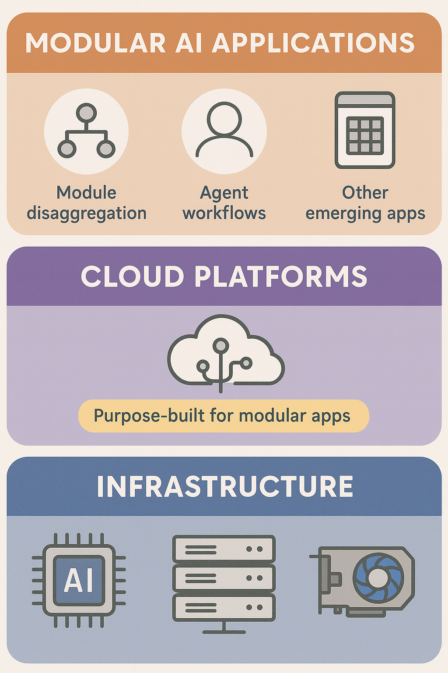
Systems for Modularization
Driven by advancements at the model, application, and infrastructure layers, the modular design paradigm will apply to a wide range of generative AI applications
Cloud platforms purpose-built for modular generative AI applications are needed—analogous to microservices platforms such as Kubernetes

Slide 10

C1
Commands & APIs & Abstraction
How users deploy modular AI applications with simple, expressive interfaces?
Open system challenges for modular paradigm
C2
Cluster Management & Scheduling
How to manage the cloud for high resource efficiency and scalability?
—the 4 C’s
C3
Communication
How modules communicate efficiently with others across scales?
C4
Compiler & Execution Runtime
How to achieve efficient execution across heterogeneous hardware?

Slide 11
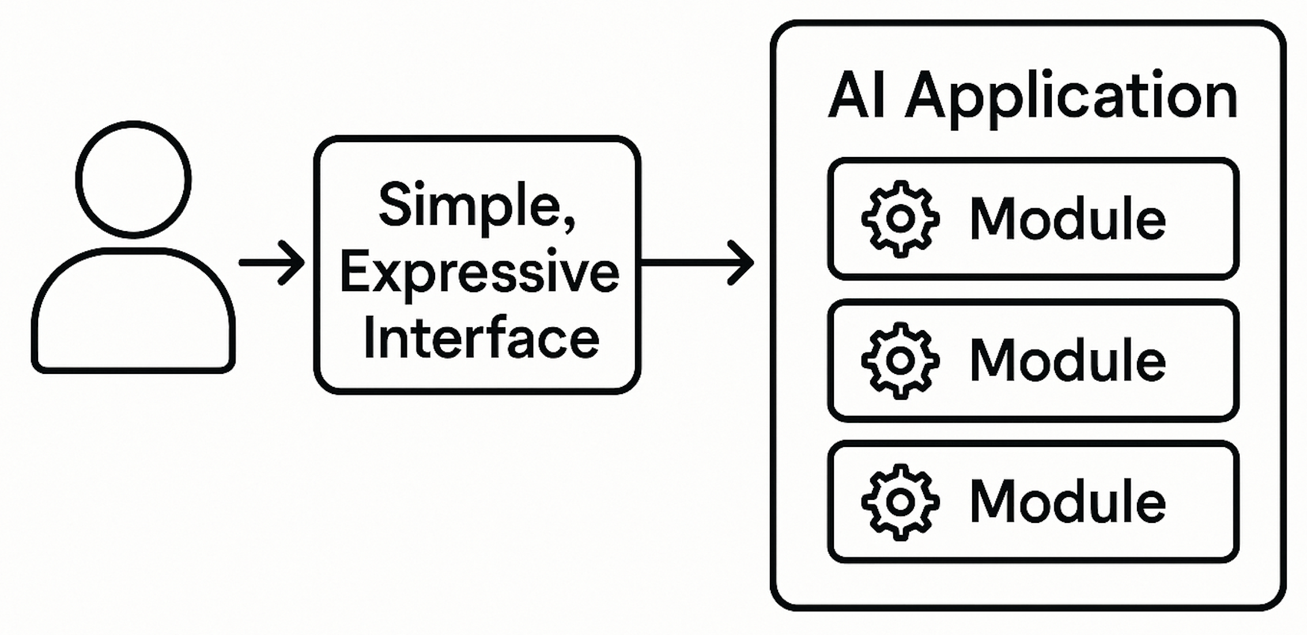
C1: Commands & APIs & Abstraction
Two approaches in current AI cloud platforms
Explicit resource provisioning and management
Service endpoints for entire models/applications
Desired properties
High level: Specify the “what” (e.g., performance goals), let systems configure the “how” (e.g., resource allocation)
Fine granularity: Support fine-grained, module-level semantics
Rich dataflow specifications: Express complex, dynamic data dependencies

Slide 12
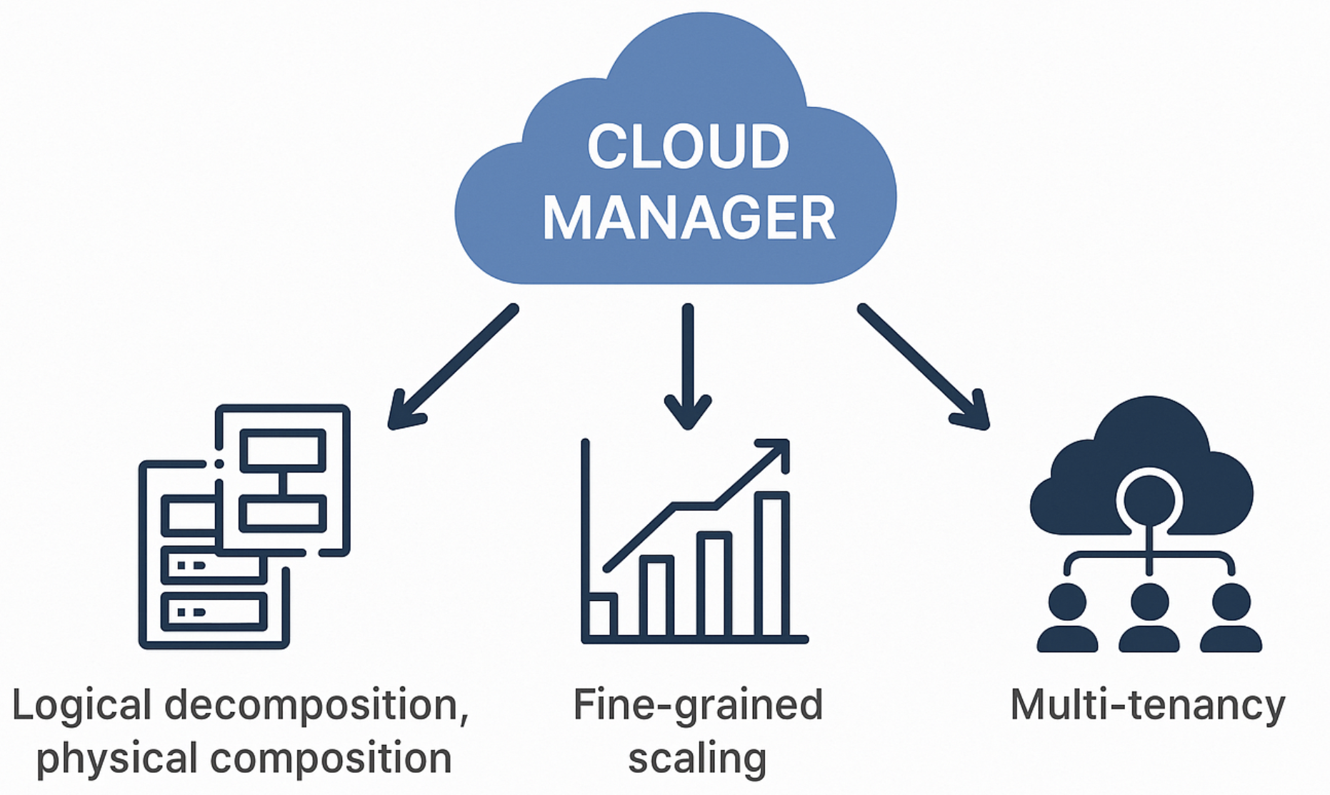
C2: Cluster Management & Scheduling
Logical decomposition, physical composition
High resource efficiency through dynamic placement and task packing
Fine-grained scaling
Precise, per-module scale-up and -down
Multi-tenancy
Efficient resource sharing
Fault isolation and handling

Slide 13
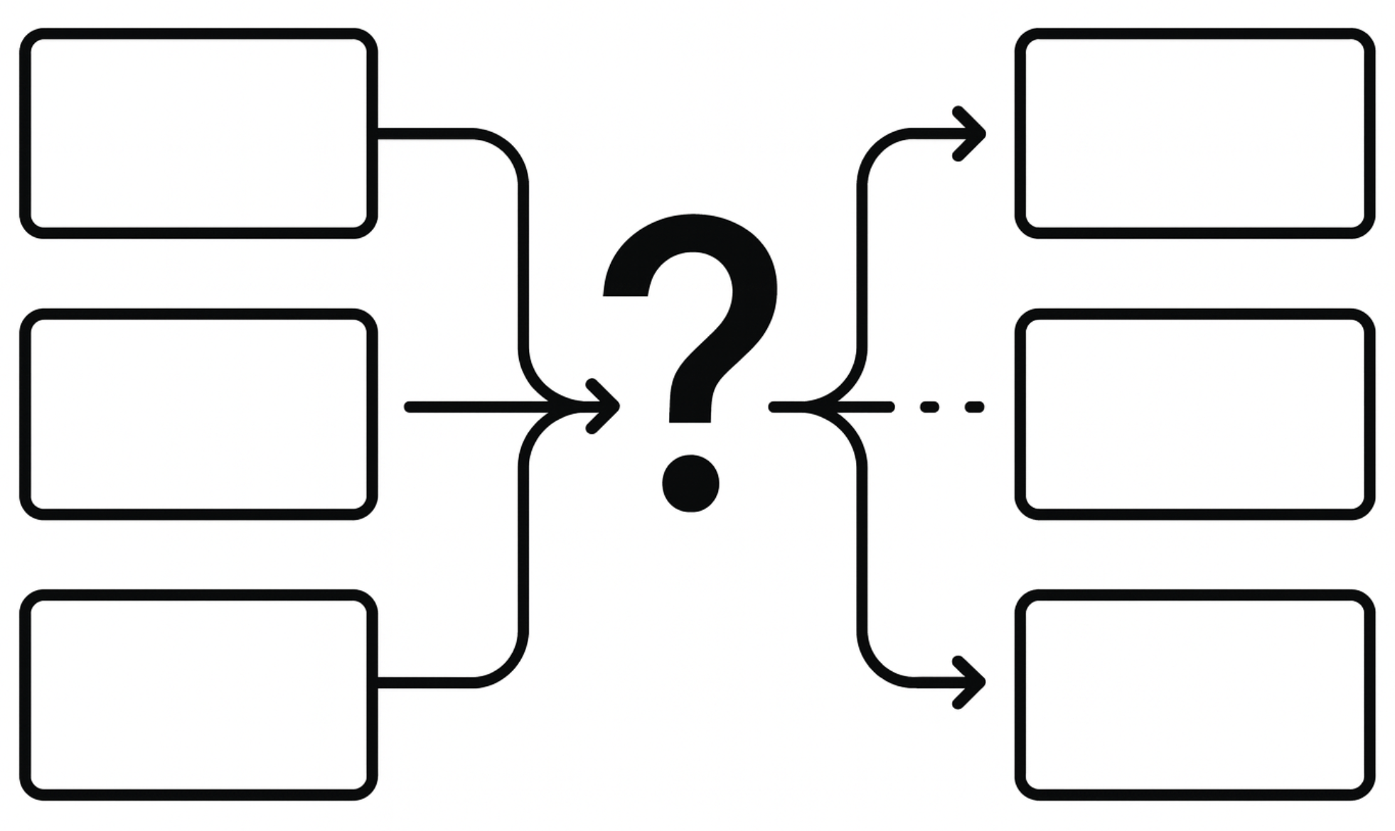
C3: Communication
Modular paradigm increases communication complexity
Pre-defined primitives vs. diverse interaction patterns
Requirements
Extensibility: Easily support new communication patterns for cross-module interactions
Fast communication: Automatic optimizations such as topology-aware routing, load balancing, etc.
Notes:
Pre-define (e.g., collective comm.), diverse requirements & patterns (existing primitives cannot adopt; streaming or )
An alternative is ad-hoc implementation using p2p communication. But clearly, not efficient and can be error-prone
What we want is out-of-box solutions, which should have two requirements

Slide 14
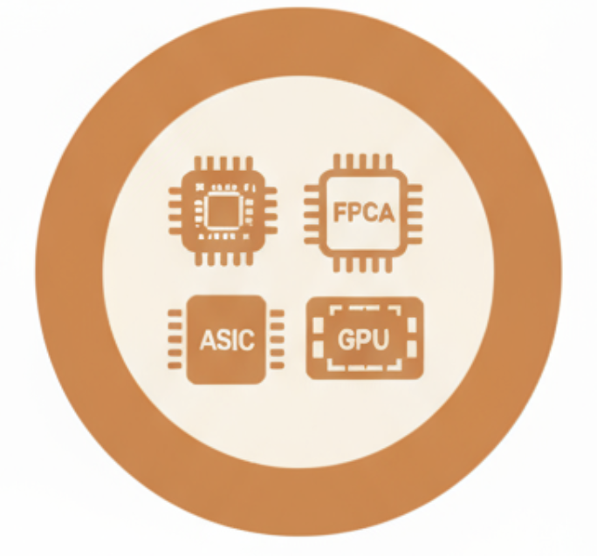


C4: Compiler & Execution Runtime
Transparency
Seamless execution across a variety of heterogeneous hardware
Minimal overhead
Low startup latency
Rapid scaling up (down) and efficient migration
Isolation
Multiple levels of isolation to suit different scenarios
Runtime

Slide 15

Benefits for Stakeholders
AI cloud users (e.g., developers)
Simplify modular deployment of AI applications at scale
Easily navigate various tradeoffs across latency, throughput, cost, etc.
Cloud providers
Improve resource efficiency and scalability

Slide 16

Concluding Remarks
Advancements at the model, application, and infrastructure layers are driving a modular design paradigm for AI cloud platforms
Open challenges across the system stack (the 4 C’s)
Benefits for various stakeholders
Acknowledgement
Prof. Wei Wang, Prof. Yue Cheng, Prof. Hong Xu, Yizhou Shan

Slide 17
Thoughts?
yuminchen@cuhk.edu.cn

